Slide 1
Discrete-Continuous Optimization for Large-scale Structure from Motion
David Crandall
School of Informatics and Computing
Indiana University
Andrew Owens
CSAIL
MIT
Noah Snavely and Dan Huttenlocher
Department of Computer Science
Cornell University

Slide 2
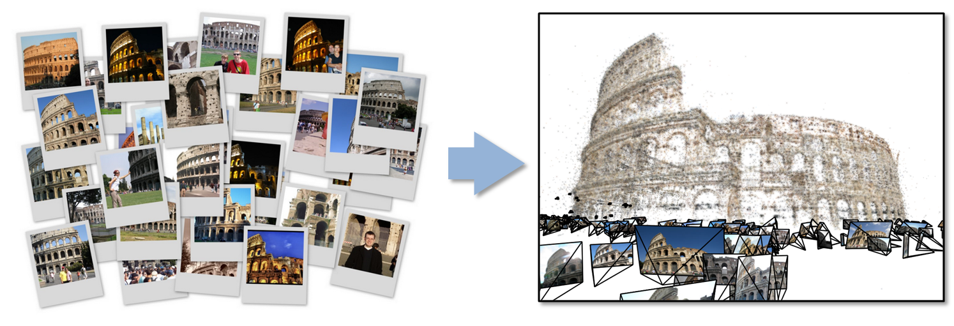
SfM from Internet Images
Recent work has built 3D models from large, unstructured online image collections
[Snavely06], [Li08], [Agarwal09], [Frahm10], Microsoft’s PhotoSynth, …
SfM is a key part of these reconstruction pipelines

Slide 3
Structure from Motion
p₄
p₁
p₃
minimize
p₂
f (R, T, P)
p₅
p₇
p₆
Camera 1
Camera 3
R₁,t₁
R₃,t₃
Camera 2
R₂,t₂
Notes:
Structure from motion solves the following problem:
Given a set of images of a static scene with 2D points in correspondence, shown here as color-coded points, find…
a set of 3D points P and
a rotation R and position t of the cameras that explain the observed correspondences. In other words, when we project a point into any of the cameras, the reprojection error between the projected and observed 2D points is low.
This problem can be formulated as an optimization problem where we want to find the rotations R, positions t, and 3D point locations P that minimize sum of squared reprojection errors f. This is a non-linear least squares problem and can be solved with algorithms such as Levenberg-Marquart. However, because the problem is non-linear, it can be susceptible to local minima. Therefore, it’s important to initialize the parameters of the system carefully. In addition, we need to be able to deal with erroneous correspondences.

Slide 4
Reconstruction pipeline
Feature detection
Feature matching
Find scene points seen by
multiple cameras
Incremental
Bundle Adjustment (IBA)
Start with seed model
Run bundle adjustment
Remove outliers
Add another image
Repeat
[Snavely06], [Li08], [Agarwal09], [Frahm10] …
Initialization
Robustly estimate camera
poses and/or scene points
Bundle adjustment
Refine camera poses R, T
and scene structure P

Slide 6
Initializing bundle adjustment
Incremental BA
Works very well for many scenes
Poor scalability, much use of bundle adjustment
Poor results if a bad seed image set is chosen
Drift and bad local minima for some scenes
Recent work: hierarchical approaches [Gherardhi10, Strecha10]

Slide 7
Batch initialization techniques
Factorization [Tomasi92], [Sturm96], [Hartley03]
Problems with missing data, robustness, …
Linear techniques [Govindu01], [Martinec07], [Sinha08], …
L∞ norm approaches [Sim06], [Kahl07], …
Sensitive to outliers
Photo metadata (e.g. geo-tags)
Too noisy to be used directly

Slide 8
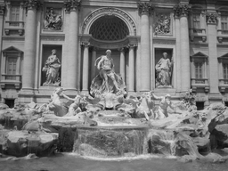
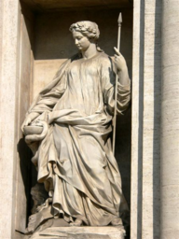
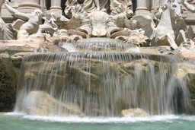
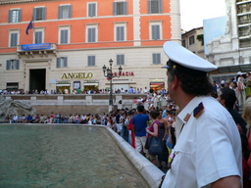
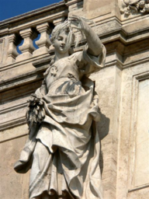
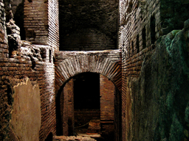
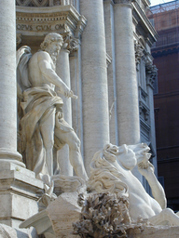
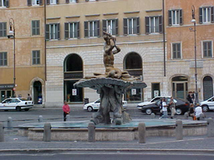
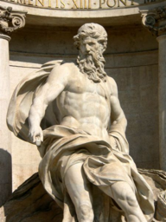
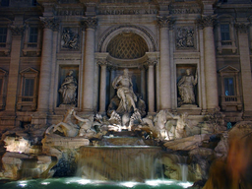
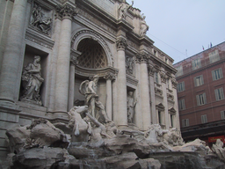
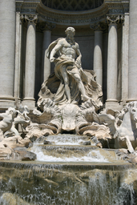
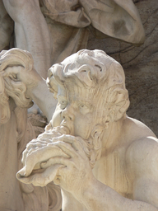
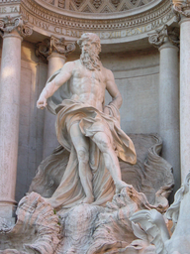
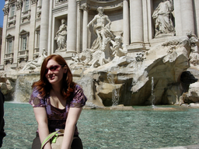
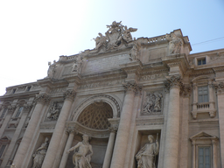
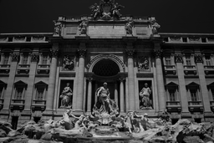
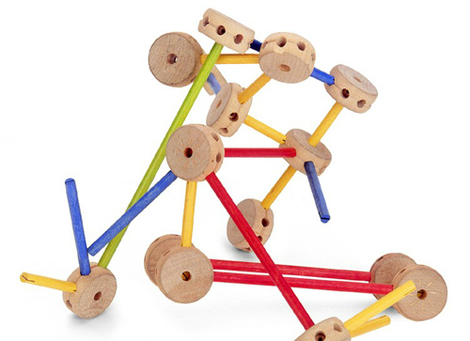
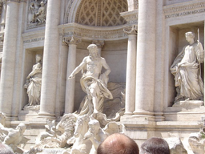
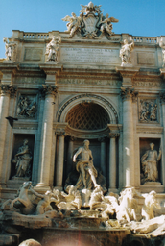
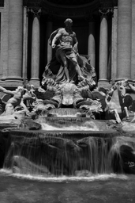
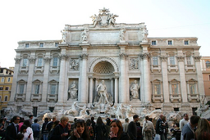
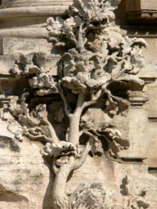
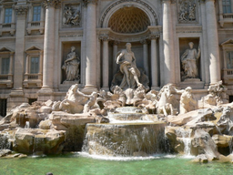
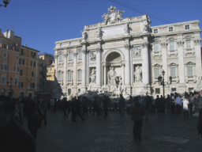
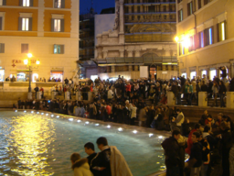
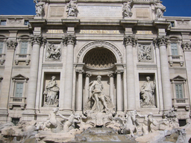
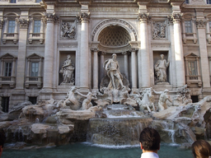
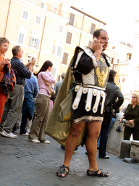
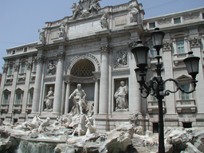
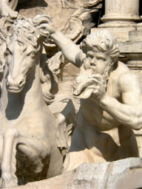
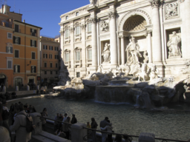
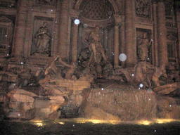
Our approach
View SfM as inference over a Markov Random Field, solving for all camera poses at once
Vertices are cameras (or points)
Both pairwise and unary constraints
Inference problem: label each image with a camera pose, such that constraints are satisfied

Slide 9
Our approach
View SfM as inference over a Markov Random Field, solving for all camera poses at once
Combines discrete and continuous optimization:
Discrete optimization (loopy belief propagation) with robust energy used to find good initialization
Continuous optimization (bundle adjustment) used to refine
Related to FusionFlow [Lempitsky08]

Slide 10
Our approach
View SfM as inference over a Markov Random Field, solving for all camera poses at once
Initializes all cameras at once
Can avoid local minima
Easily parallelized
Up to 6x speedups over incremental bundle adjustment for large problems

Slide 11
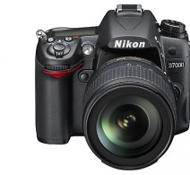
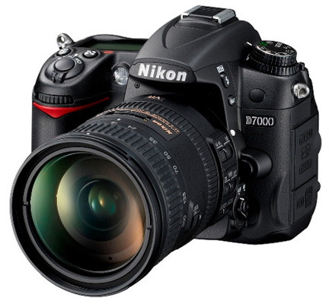
The MRF model
Input: set of images with correspondence
binary constraints: pairwise camera transformations
unary constraints: pose estimates (e.g., GPS, heading info)
3D points can also be modeled
Notes:
Tie to normal MRFs.

Slide 12
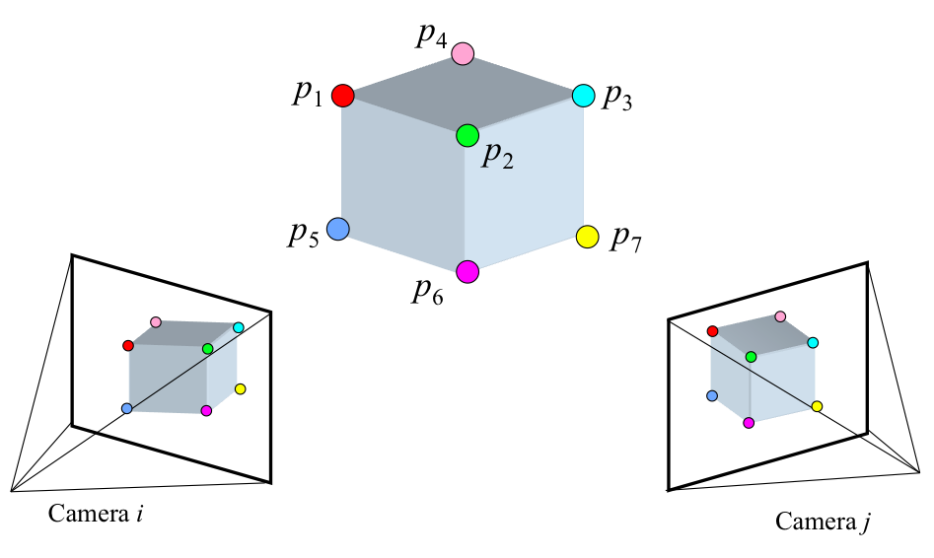
Constraints on camera pairs
Compute relative pose between camera pairs using 2-frame SfM [Nister04]
R_{ij}
relative 3d rotation
t_{ij}
relative translation direction

Slide 13
Constraints on camera pairs
R_{ij}
t_{ij}
relative 3d rotation
relative translation direction
Find absolute camera poses (R_{i}, t_{i}) and (R_{j}, t_{j}) that agree with these pairwise estimates:
rotation consistency
translation direction consistency

Slide 14
Constraints on camera pairs
R_{ij}
t_{ij}
relative 3d rotation
relative translation direction
Define robustified error functions to use as pairwise potentials:
rotation consistency
translation direction consistency

Slide 15
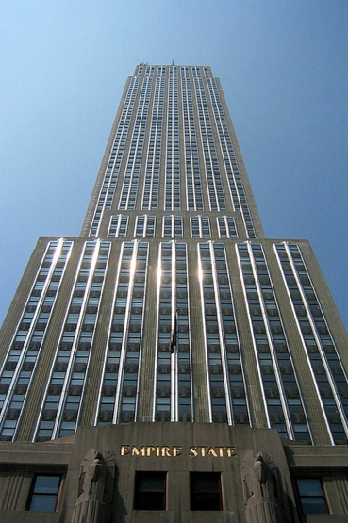
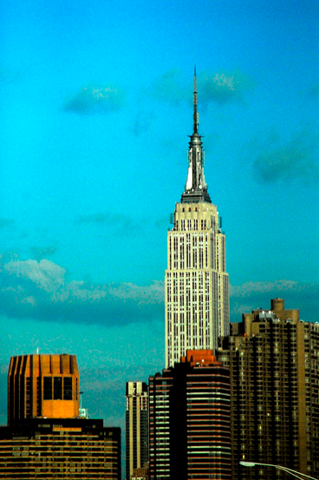
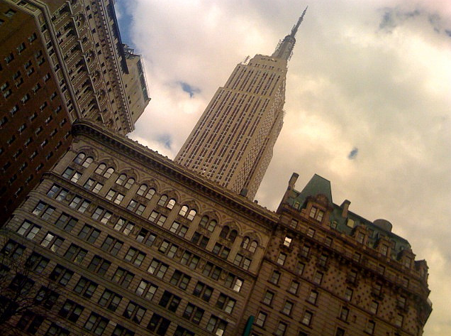
Prior pose information
Noisy absolute pose info for some cameras
2D positions from geotags (GPS coordinates)
Orientations (tilt & twist angles) from vanishing point detection [Sinha10]

Slide 16
Prior pose information
Noisy absolute pose info for some cameras
2D positions from geotags (GPS coordinates)
Orientations (tilt & twist angles) from vanishing point detection
Rotations unary potential
Translations unary potential
d^{θ}, d^{φ}, d^{ϕ} measure robust
error wrt prior pose estimate
g_{i} is a GPS coordinate
en & π project into a common coordinate system
ρ_{T} is a robust distance function

Slide 17
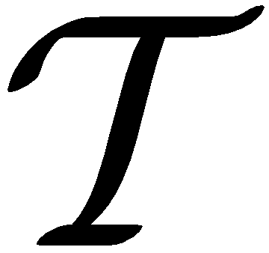
Overall optimization problem
Given pairwise and unary pose constraints, solve for absolute camera poses simultaneously
for n cameras, estimate
= (R₁, R₂, …, R_{n}) and = (t₁, t₂, …, t_{n})
so as to minimize total error over the entire graph
pairwise rotation consistency
unary rotation consistency
pairwise translation consistency
unary translation consistency

Slide 18
Solving the MRF
Use discrete loopy belief propagation [Pearl88]
Up to 1,000,000 nodes (cameras and points)
Up to 5,000,000 edges (constraints between cameras and points)
6-dimensional label space for cameras (3-dimensional for points)

Slide 19
Solving the MRF
Reduce 6-dimensional label space by…
Solving for rotations & translations independently[Martinec07], [Sim06], [Sinha08]
Assuming camera twist angles are near 0
Initially solving for 2D camera positions
Speed up BP by…
Using a parallel implementation on a cluster
Using distance transforms (aka min convolutions) to compute BP messages in O(L) time in # of labels (instead of O(L²)) [Felzenszwalb04]

Slide 20
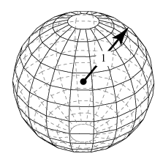
Discrete BP: Rotations
Parameterize viewing directions as points on unit sphere
Discretize into 10x10x10 = 1,000 possible labels
Measure rotational errors as robust Euclidean distances on sphere (to allow use of distance transform)

Slide 21
Discrete BP: Translations
Parameterize positions as 2D points in plane
Use approximation to error function
(to allow use of distance transforms)
Discretize into up to 300 x 300 = 90,000 labels

Slide 22
Our approach
Pairwise reconstructions, geotags, VPs
Discrete BP optimization over viewing directions
Initial rotations
NLLS refinement of rotations
Discrete BP optimization over 2D translations
Refined rotations
Initial translations, 2D points
NLLS refinement of 3D translations
Initial 3D camera poses, 3D points

Slide 23
SfM on unstructured photo collections
Feature point detection
Image matching
Find scene points seen by
multiple cameras
Discrete optimization over viewing directions
Initialization
Robustly estimate camera
poses and/or scene points
NLLS refinement of rotations
Discrete optimization over 2D translations
Bundle adjustment
Refine camera poses R, T
and scene structure P
NLLS refinement of 3D translations

Slide 24
Experimental results
Evaluated on several Flickr datasets
Download photos (highest resolution available) & geotags (if available)
Removed images with missing EXIF focal lengths
Removed panoramic and high-twist images
To build the image match graph
Used vocabulary tree and inverted files to find similar photos [Agarwal09]
Matched images with nearby geotags, closing triangles and performing successive rounds of query expansion [Frahm10]

Slide 25
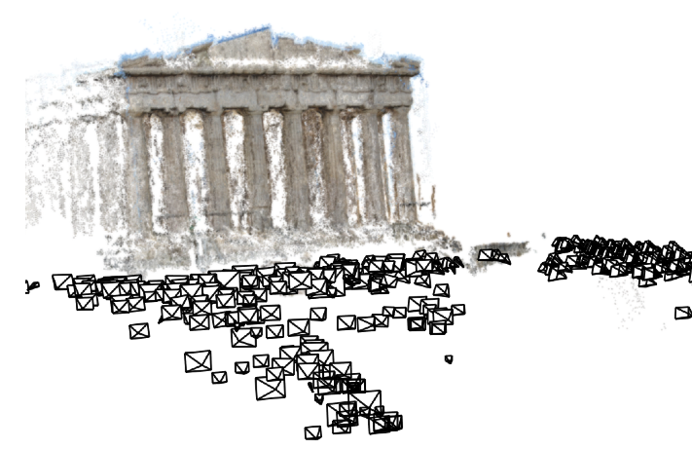
Acropolis Reconstructed images: 454 Edges in MRF: 65,097
Median camera pose difference
wrt IBA: 0.1m

Slide 26
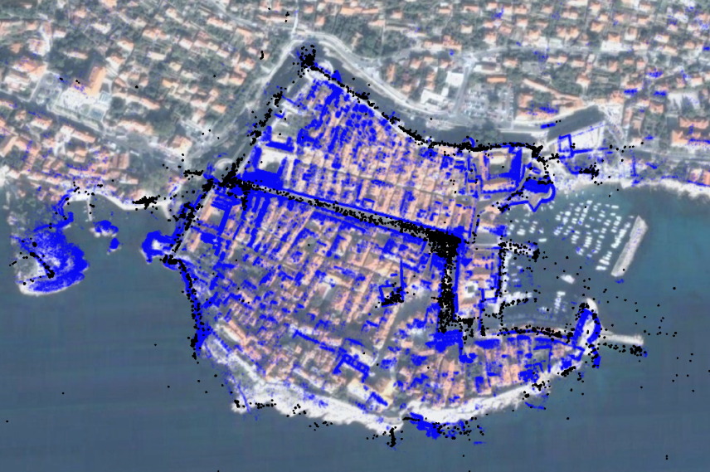
Dubrovnik (Croatia) Reconstructed images: 6,532 Edges in MRF: 1,835,488
Median camera pose difference wrt IBA: 1.0m

Slide 27
Quad Reconstructed images: 5,233 Edges in MRF: 995,734

Slide 28
Ground truth dataset
Captured 348 photos of Quad from locations surveyed with differential GPS
Allows for ground truth comparison of reconstructed camera positions
Median error wrt ground truth: 1.16m for our approach (vs 1.01m for IBA)

Slide 29
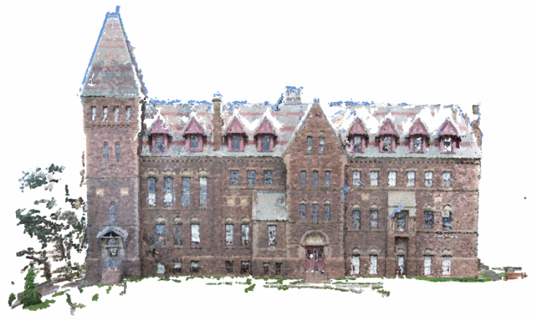
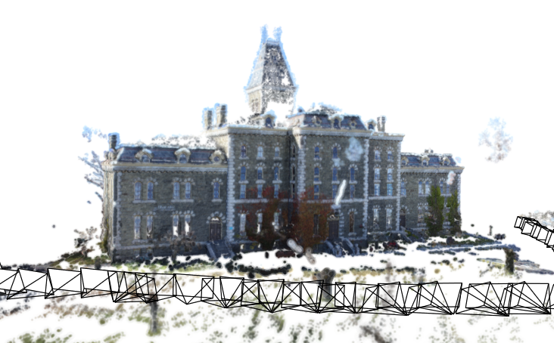
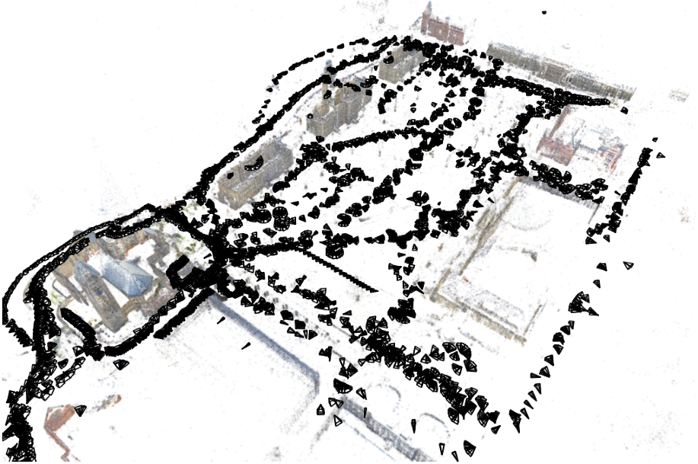
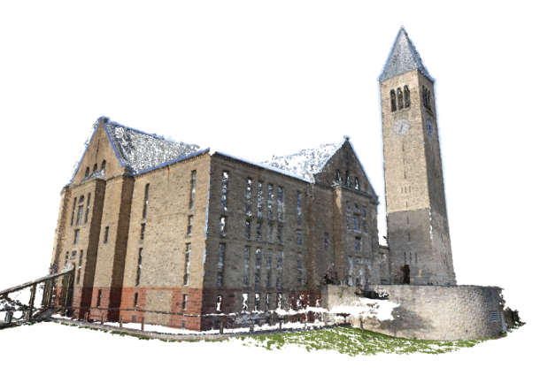
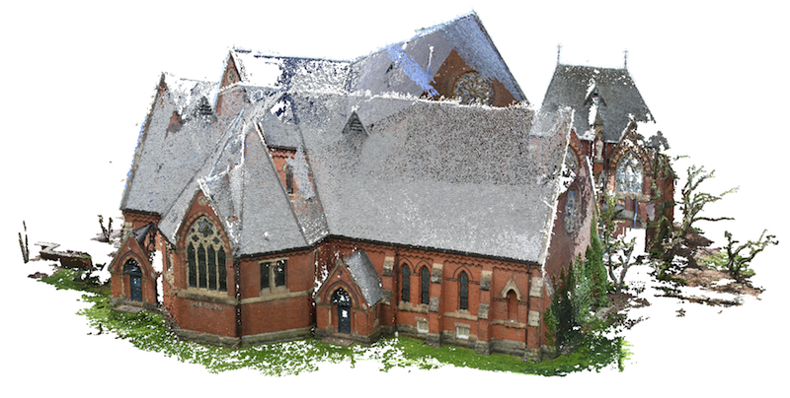
Quad Total images: 6,514 Reconstructed images: 5,233 Edges in MRF: 995,734
Ground truth for 348 cameras
Median error wrt ground truth:
1.16m (vs 1.01 for IBA)

Slide 30
Central Rome Reconstructed images: 14,754 Edges in MRF: 2,258,416

Slide 31
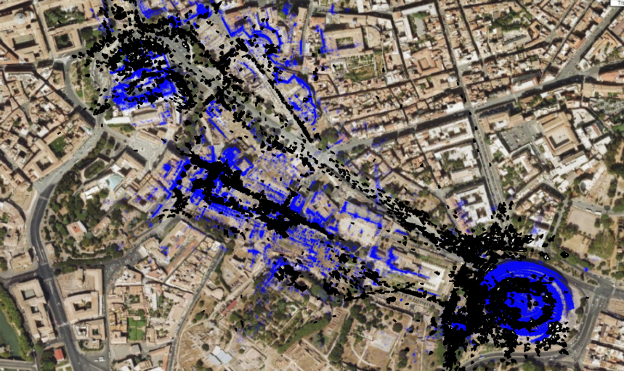
Central Rome Reconstructed images: 14,754 Edges in MRF: 2,258,416
Median camera pose difference
wrt IBA: 25.0m
Our result
Incremental
Bundle Adjustment
[Agarwal09]

Slide 32
After discrete BP

Slide 33
After bundle adjustment

Slide 34
Running times
Our results are about as good as or better than IBA, but at a fraction of the computational cost
Favorable asymptotic complexity
BP is easy to parallelize on a cluster, unlike BA

Slide 35
Limitations and future work
Inference on large random fields with huge label spaces
Hierarchical state spaces?
Dynamic, non-uniform state space discretization?
Other inference techniques? (sampling, …)
Solving for rotations and translations simultaneously
Currently require geotags for some images
Using other prior information
Orientation sensors, image shadows, etc.
Larger image collections

Slide 36
Acknowledgements
Jon Kleinberg
The Lilly Foundation
Indiana University Data to Insight Center
NSF Grant 0964027
Indiana University UITS supercomputing center
Cornell Center for Advanced Computing
Cornell Campus Planning Office
MIT Lincoln Labs
Quanta Computer
Intel
Google

Slide 37
Summary
A new SfM method for global initialization of cameras and points
Uses combination of discrete and continuous optimization to initialize bundle adjustment
More robust reconstructions for some scenes
Up to 6x speedups over incremental bundle adjustment for large problems
http://vision.soic.indiana.edu/disco

Slide 38
Running times detail

Slide 39
Comparison with IBA

Slide 40
Dataset details

Slide 41
Quad results

Slide 45
Approximation Visualization
Cost as function of t_{j}

